Slide 1

Faculty of Applied Engineering and Urban Planning
Civil Engineering Department
Dr. Eng. Mustafa Maher Al-tayeb
2 Semester 2022/2023
Probabilistic and Statistical

Slide 2
Probabilistic and Statistical Techniques
Statistics
is the science and art of collecting, summarizing, and analyzing data that are subject to random variation.

Slide 3

Probabilistic and Statistical Techniques
Definitions
Data
Observations (such as measurements, genders, survey responses) that have been collected
A variable
a
characteristic
or
attribute
that
can
assume
different
values.

Slide 4
Probabilistic and Statistical Techniques
Types of Statistics
Descriptive Statistics
Methods of organizing, summarizing and presenting data in an informative way.
Inferential Statistics
The methods used to determine something about a population on the basis of a sample.
Lecture 2

Slide 5
Probabilistic and Statistical Techniques
Definitions
Population
the complete collection of all elements (scores, people, measurements, and so on) to be studied; the collection is complete in the sense that it includes all subjects to be studied
Census
Collection of data from every member of a population
Sample
Sub collection of members selected from a population
Lecture 2

Slide 6
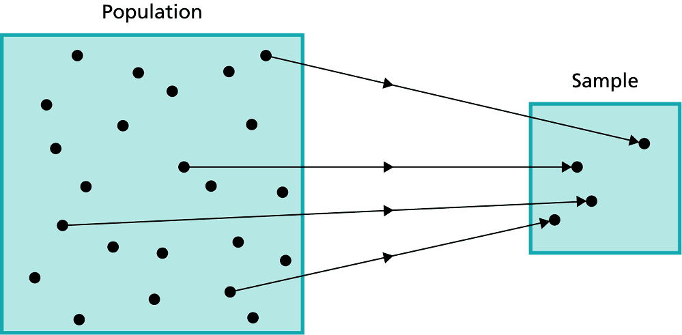
Probabilistic and Statistical Techniques
Lecture 2

Slide 7
Probabilistic and Statistical Techniques
Parameter
a numerical measurement describing some characteristic of a population.
Population
Parameter
Lecture 2

Slide 8
Probabilistic and Statistical Techniques
Statistic
a numerical measurement describing some characteristic of a sample.
Sample
Statistic
Lecture 2

Slide 9
Common Summary Measures
Probabilistic and Statistical Techniques
Sample Statistic
Population Parameter
Mean
‾
μ
X
Standard
Deviation
S
σ
Variance
S²
σ²
Lecture 2

Slide 10
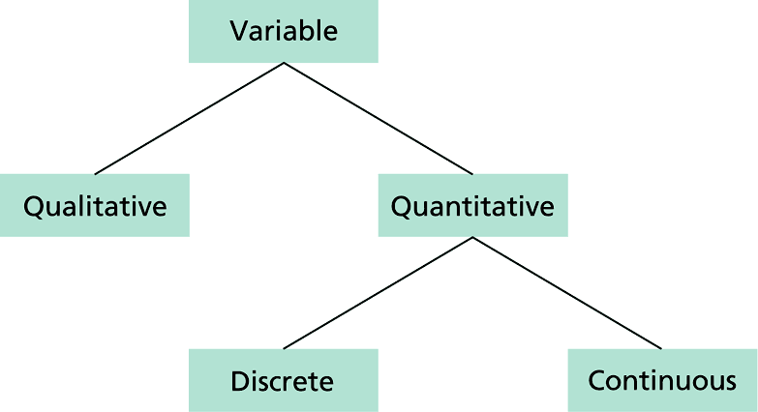
Probabilistic and Statistical Techniques
Types of Data
Data
Lecture 2

Slide 11
Probabilistic and Statistical Techniques
Quantitative data
When the variable studied can be reported numerically, the variable is called a quantitative variable.
Example: The income of college graduates, children in a family, height of a student.
Qualitative (or attribute) data
When the characteristic being studied is nonnumeric, it is called a qualitative variable.
Example: The genders (male/female), eye color, type of cars owned, marital status.
Lecture 2

Slide 12
Probabilistic and Statistical Techniques
Working with Quantitative Data
Quantitative data can further be described by distinguishing between discrete and continuous types.
Lecture 2

Slide 13
Probabilistic and Statistical Techniques
Discrete data
Can assume only certain values, and there are usually gaps between the values.
Example: The number of Lumps that a factory can produce, the number of bedrooms in a house.
Lecture 2

Slide 14
Probabilistic and Statistical Techniques
Continuous (numerical) data
Observations of continuous variables can assume any value within a specific range.
Examples: The air pressure in a tire, and the weight of a shipment of tomatoes
Lecture 2

Slide 15
Probabilistic and Statistical Techniques
Uses & Abuses of Statistics
Lecture 2

Slide 16
Probabilistic and Statistical Techniques
Misuse # 1- Bad Samples
Voluntary response sample (or self-selected sample), one in which the respondents themselves decide whether to be included
In this case, valid conclusions can be made only about the specific group of people who agree to participate.
Lecture 2

Slide 17
Probabilistic and Statistical Techniques
Misuse # 2- Small Samples
Conclusions should not be based on samples that are far too small.
Example: Basing a school suspension rate on a sample of only three students
Lecture 2

Slide 18
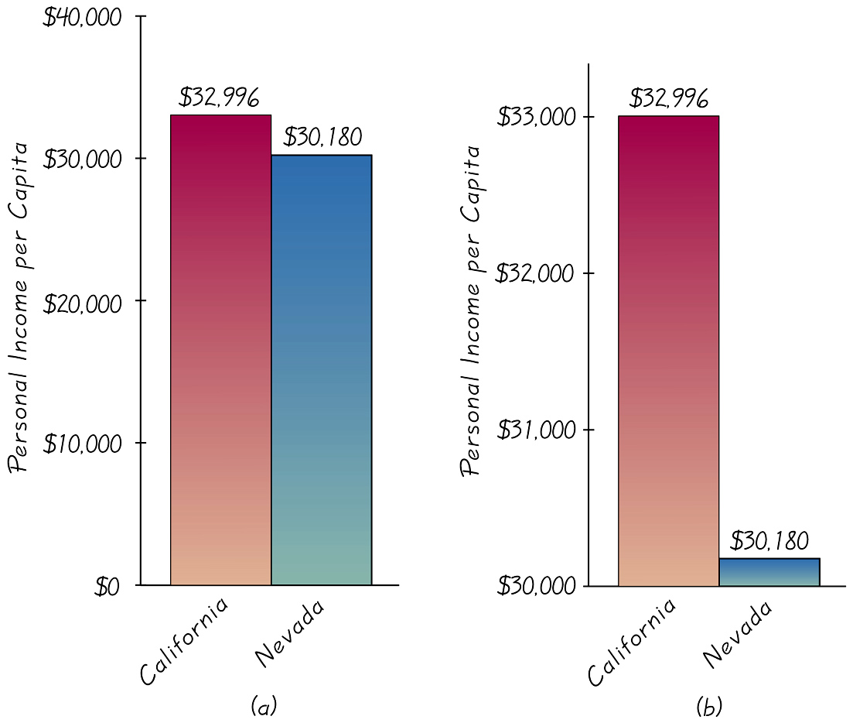
Probabilistic and Statistical Techniques
Misuse # 3- Graphs
To correctly interpret a graph, you must analyze the numerical information given in the graph, so as not to be misled by the graph’s shape.
Lecture 2

Slide 19
Probabilistic and Statistical Techniques
Misuse # 4- Percentages
Misleading or unclear percentages are sometimes used. For example, if you take 100% of a quantity, you take it all. 110% of an effort does not make sense.
Lecture 2

Slide 20
Probabilistic and Statistical Techniques
Sample Size
Lecture 2

Slide 21
Probabilistic and Statistical Techniques
Sample Size
use a sample size that is large enough to see the true nature of any effects and obtain that sample using an appropriate method, such as one based on randomness
Lecture 2

Slide 22
Probabilistic and Statistical Techniques
Methods of Sampling - Summary
Random
Systematic
Convenience
Stratified
Cluster
Lecture 2

Slide 23
Probabilistic and Statistical Techniques
Random Sample
Members of the population are selected in such a way that each individual member has an equal chance of being selected
Lecture 2

Slide 24
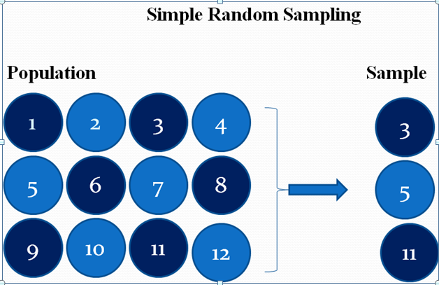
Probabilistic and Statistical Techniques
Methods of Sampling
Random Sampling
selection so that each
individual member has an
equal chance of being selected
Lecture 2

Slide 25
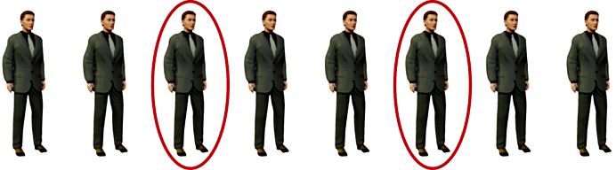
Probabilistic and Statistical Techniques
Systematic Sampling
Select some starting point and then
select every k ^{th} element in the population
Lecture 2

Slide 26
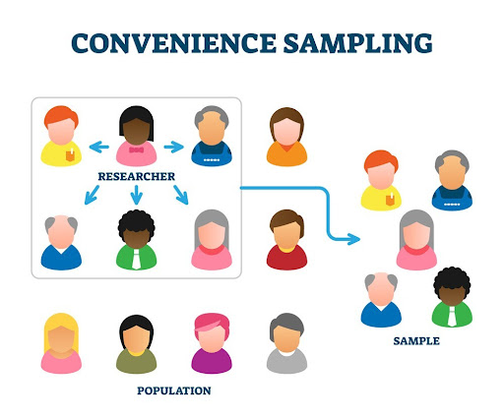
Probabilistic and Statistical Techniques
Convenience Sampling
use results that are easy to get
Lecture 2

Slide 27
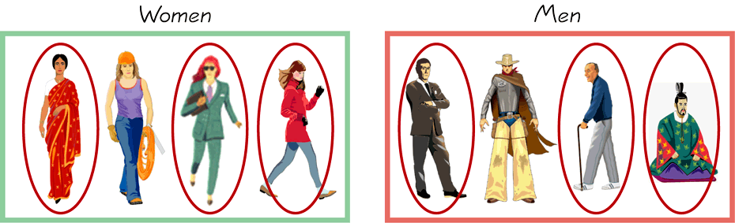
Probabilistic and Statistical Techniques
Stratified Sampling
subdivide the population into at least two different subgroups that share the same characteristics, then draw a sample from each subgroup
Lecture 2

Slide 28
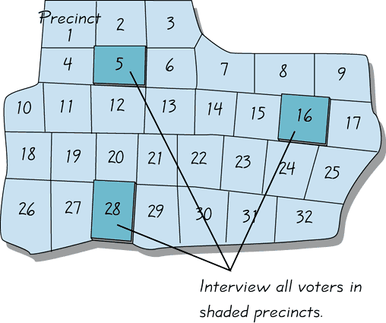
Probabilistic and Statistical Techniques
Cluster Sampling
divide the population into sections (or clusters); randomly select some of those clusters; choose all members from selected clusters
Lecture 2

Slide 29

Probabilistic and Statistical Techniques
Lecture 2

